Slide 1

Real-time systems
Using PLCs to implement
LADDER , Petri Nets and GRAFCET Diagrams

Slide 2
Topics
The PLC (notion, architecture, working,…)
PLC programming languages (Ladder, IL, Grafcet)
Conversion between models
Exercises

Slide 3
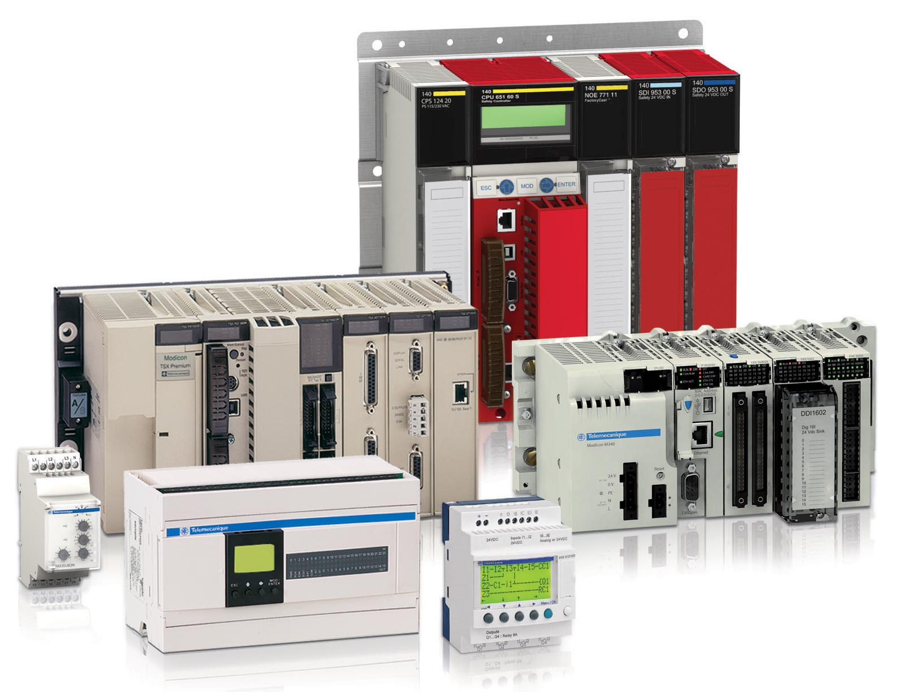
PLCs
http://machinedesign.com/engineering-essentials/engineering-essentials-what-programmable-logic-controller

Slide 4
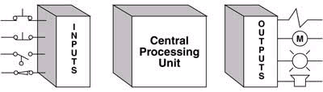
PLC definition
A PROGRAMMABLE LOGIC CONTROLLER (PLC) is an industrial computer control system that continuously monitors the state of input devices and makes decisions based upon a custom program to control the state of output devices.
Almost any production line, machine function, or process can be greatly enhanced using this type of control system. However, the biggest benefit in using a PLC is the ability to change and replicate the operation or process while collecting and communicating vital information.
Another advantage of a PLC system is that it is modular. That is, you can mix and match the types of Input and Output devices to best suit your application.

Slide 5
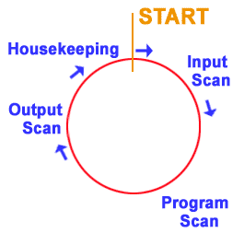
Scan cycle
Four Steps In The PLC Operations
1) Input Scan
Detects the state of all input devices that are connected to the PLC
2) Program Scan
Executes the user created program logic
3) Output Scan
Energizes or de-energize all output devices that are connected to the PLC.
4) Housekeeping
This step includes communications with programming terminals, internal diagnostics, etc...

Slide 6
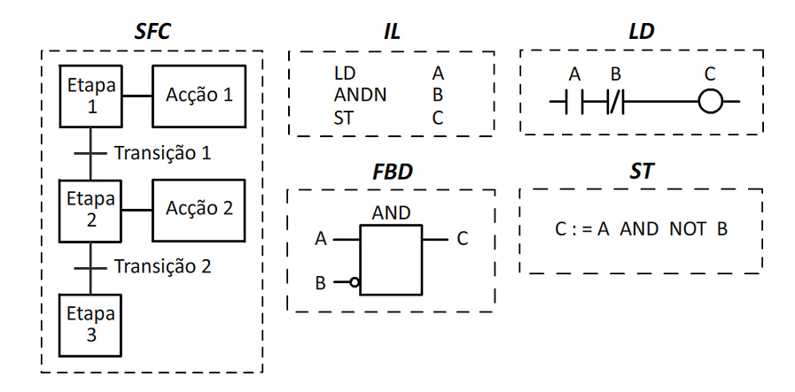
Languages of the spacification standard IEC 61131-3 .
IL
GRAFCET (Sequencial Function Chart - SFC)
Instruction List - IL
Ladder Diagrams - LD
Function Block Diagrams - FBD
Structured Text - ST
NETWORK 1
LD I0.0
A I0.1
= Q0.0
Por: Elton Ribeiro Matias

Slide 7
Our study will be based on the Siemens S7-200

Slide 8
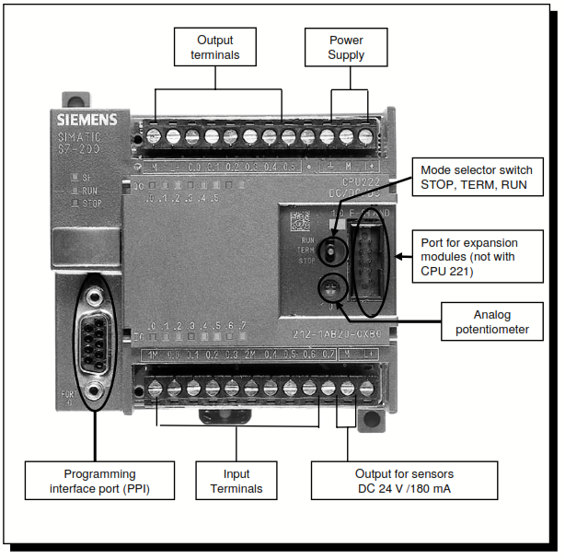
Structure of a S7-200 CPU

Slide 9
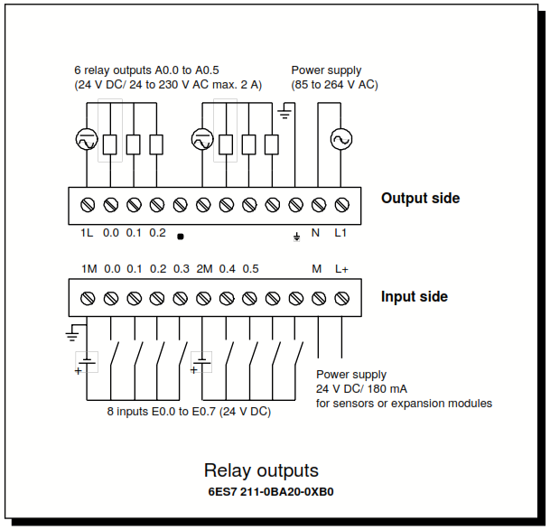
Terminal diagram of the S7-200

Slide 10
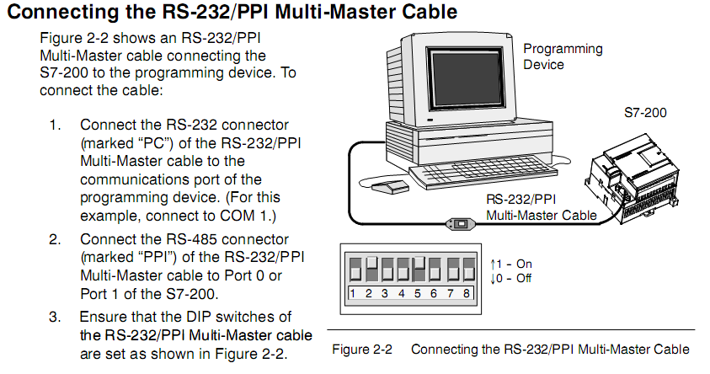
Connection to a computer

Slide 11
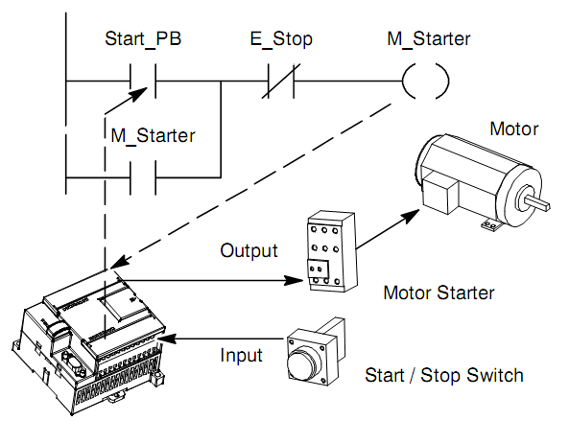
Using a PLC

Slide 12
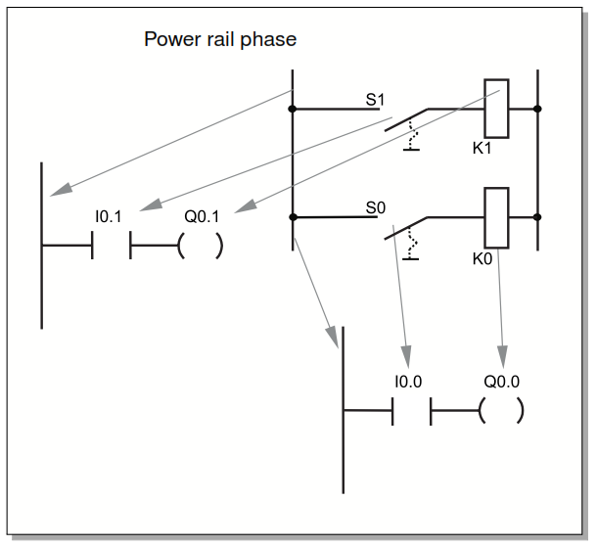
Correspondence to original relay logic

Slide 13
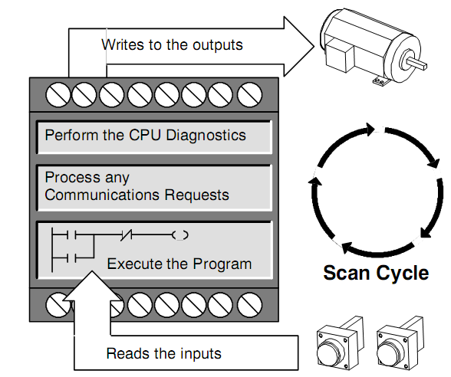
Working principle of PLCs
The S7-200 continuously cycles through the control logic in your program, reading and writing data. The S7-200 Relates Your Program to the Physical Inputs and Outputs :
Reading the inputs: The S7-200 copies the state of the physical inputs to the process-image input register.
Executing the control logic in the program: The S7-200 executes the instructions of the program and stores the values in the various
Processing any communications requests: The S7-200 performs any tasks required for communications.
Executing the CPU self-test diagnostics: The S7-200 ensures that the firmware, the program memory, and any expansion modules are working properly.
Writing to the outputs: The values stored in the process image output register are written to the physical outputs.

Slide 14
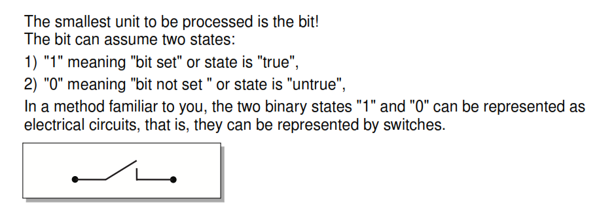
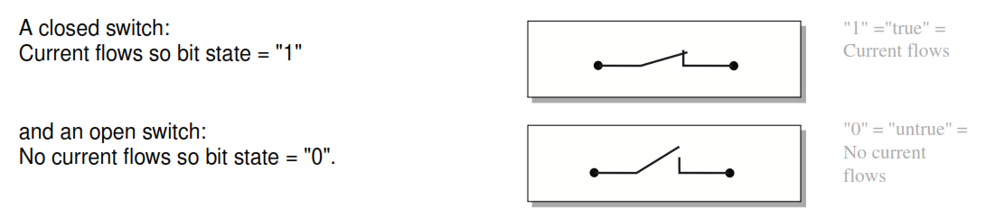
The Logic is based on contacts

Slide 15
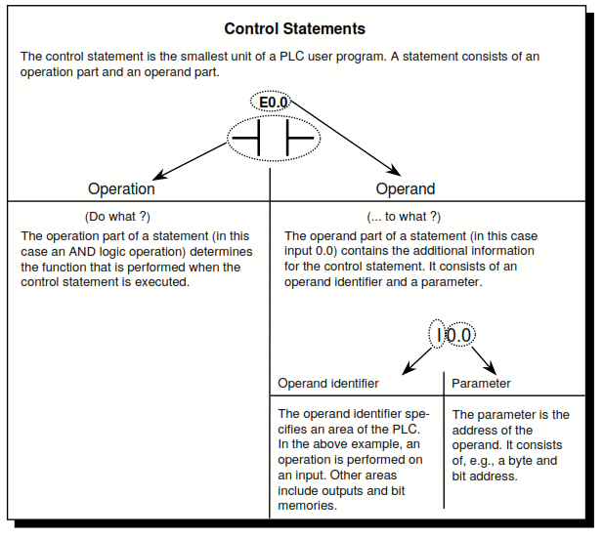
Basic statements

Slide 16
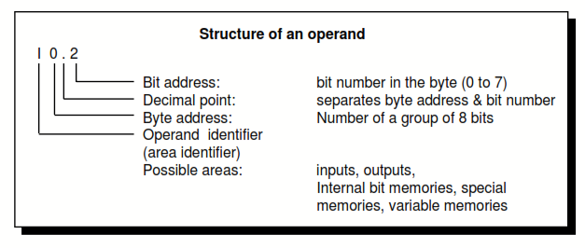
Structure of an operand

Slide 17
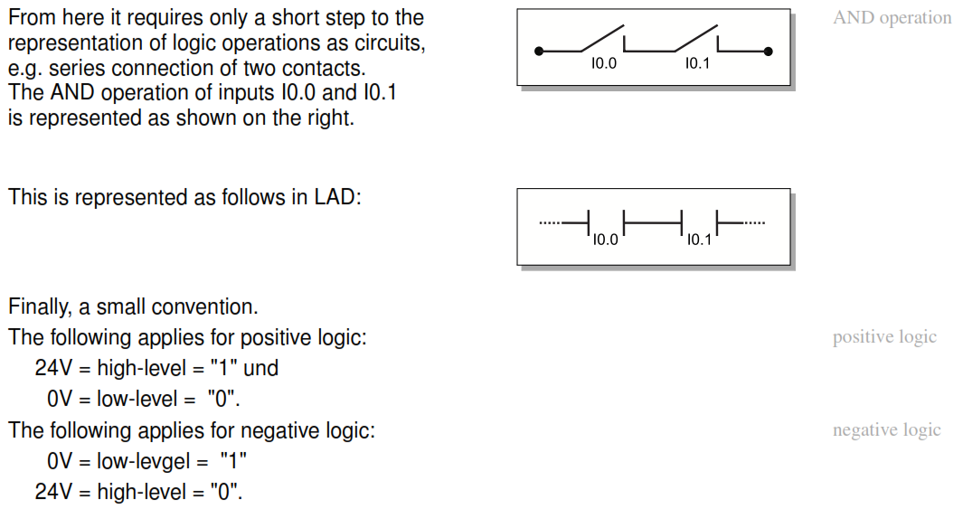
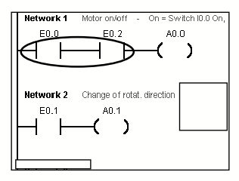
“And” logic operation

Slide 18
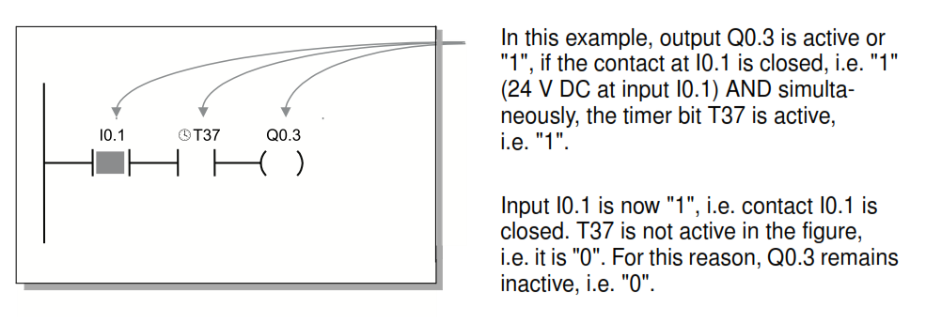
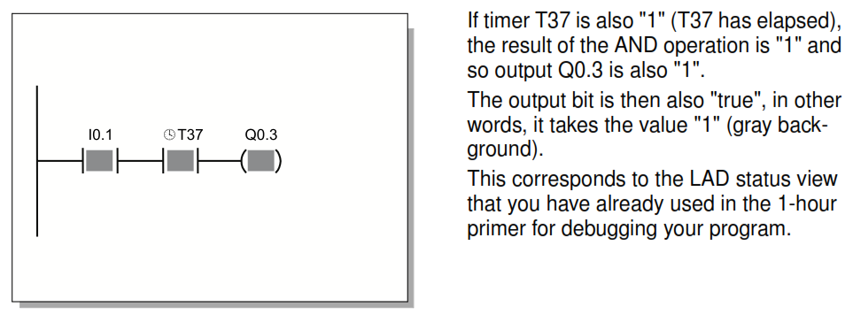
Current Flow in the Ladder Diagram

Slide 19
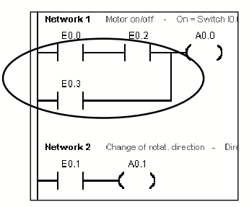
“Or” Logic operation
The diagram expresses the following logic operations:
A0.0 = (E0.0 /\ E0.2) \/ E03
A0.1 = E0.1

Slide 20
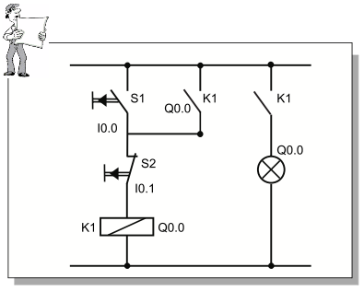
Making a standard “lock”
You are sure to be familiar with the standard latching function and here you will learn how to program it.
The example:
Output Q0.00 is to be activated as soon as S1 at input I0.0 is operated. With latching, Q0.0 is to remain active until S2 at input I0.1 is operated and thus interrupts the latch.

Slide 21
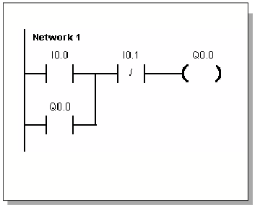
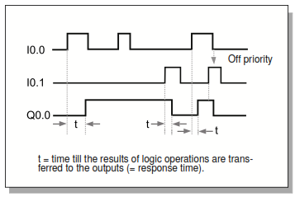
Latching (retentive state)
To allow the latching function to work, the output (Q0.0 in this case), must itself ensure, as soon as it is activated, that it retains its "true" state and therefore remains active.
This is achieved by switching the output (Q0.0 in this case) as a contact in parallel to the tripping input just in the same way as with a conventional contactor circuit (Q0.0 can be compared to our contactor K1).
To allow the latching function to be terminated again, input I0.1 is to work like a break in the current path when operated.
If a current path is interrupted (i.e. state "0" exists) when a switch is operated, this is referred to as an NC contact.
Consequently, an element must be inserted which works as an NC contact in the ladder diagram when there are 24 V DC ("true") at input I0.1.X
Q0.0 as an input ensures latching

Slide 22
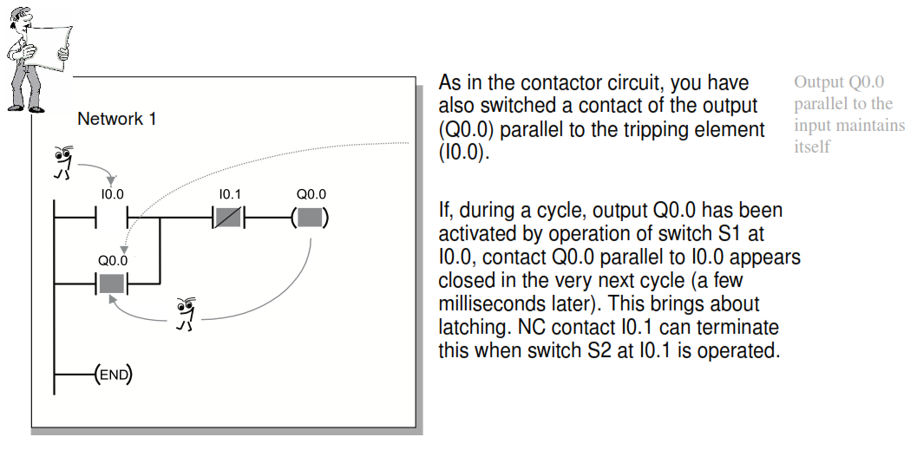
Solution description and test

Slide 23
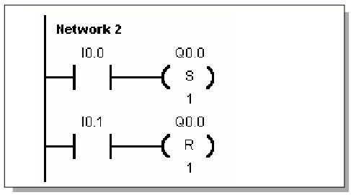
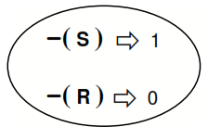
A Different Take on Latching ... (1)
In PLC technology, latching is often also implemented in another variant:
Instead of feeding back the output - as in the previous example - here the functions "Set" and "Reset" are simply used instead..
Because of the "Set" operation - (S), a switching pulse at I0.0 has the effect that Q0.0 is activated in a steady state. In contrast, because of the "Reset“ operation - (R), a switching pulse at I0.1 has the effect that Q0.0 is deactivated again.
Number of bits next to Q0.0 that are set/reset.

Slide 24
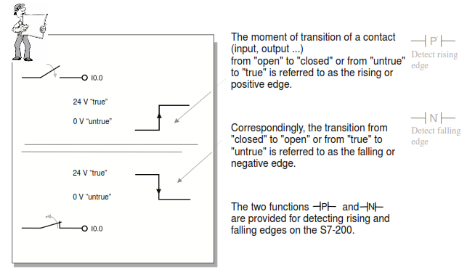
Edge detection (events)

Slide 25
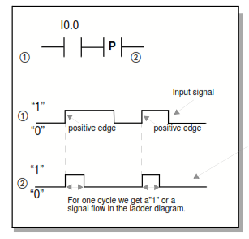
The pulse “contact”
The -|P|- and –N|- are provided for detecting rising and falling edges on the S7-200.
In the figure -|P|- works as follows:
The contact for detecting rising edges is closed for the duration of one cycle when the series connected contact changes from "untrue" to "true“.

Slide 26
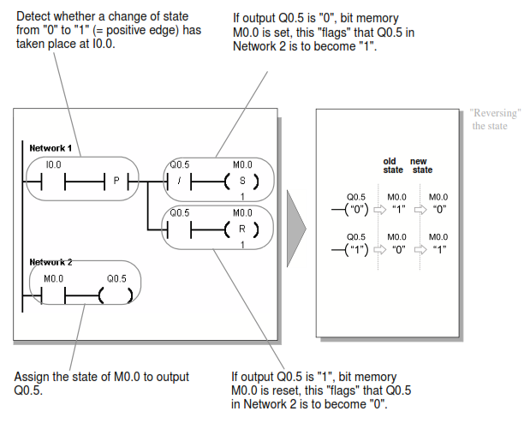
Pulse operated switch example

Slide 27
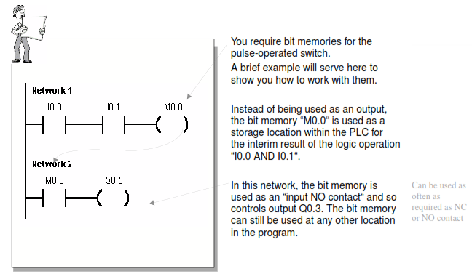
Bit memories

Slide 28
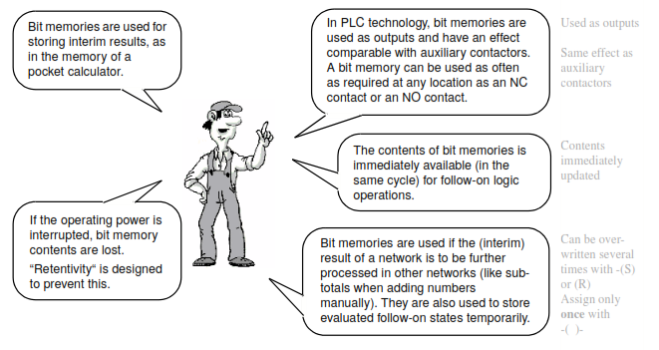
Bit memories utilization

Slide 29
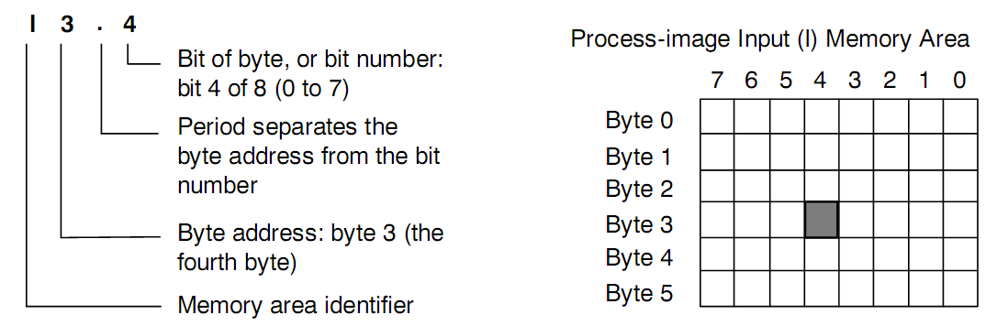
The process image input memory area

Slide 30
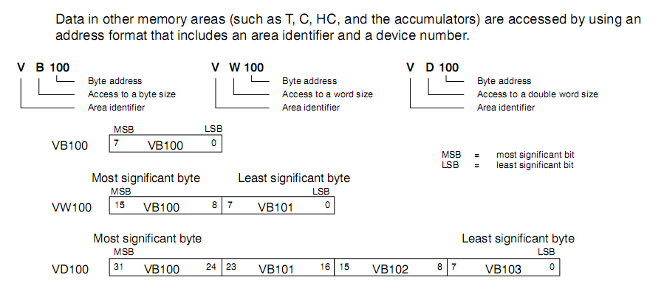
Memory types
Bit memory: I0.0, V0.1, M1.3, …
Bytes: VB100, VB101, …
Words: VW: VW100, VW102, …
Doubles: VD100, VD103, …

Slide 31
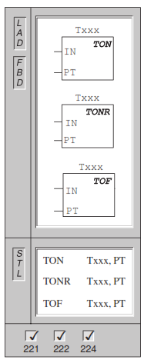
Timers
On-Delay Timer, Retentive On-Delay Timer, Off-Delay Timer.
The On-Delay Timer and Retentive On-Delay Timer instructions count time when the enabling input is ON. When the current value (Txxx) is greater than or equal to the preset time (PT), the timer bit is ON.
The On-Delay timer current value is cleared when the enabling input is OFF, while the current value of the Retentive On-Delay Timer is maintained when the input is OFF. You can use the Retentive On-Delay Timer to accumulate time for multiple periods of the input ON. A Reset instruction (R) is used to clear the current value of the Retentive On-Delay Timer.
Both the On-Delay Timer and the Retentive On-Delay Timers continue counting after the Preset is reached, and they stop counting at the maximum value of 32767.
The Off-Delay Timer is used to delay turning an output OFF for a fixed period of time after the input turns OFF. When the enabling input turns ON, the timer bit turns ON immediately, and the current value is set to 0. When the input turns OFF, the timer counts until the elapsed time reaches the preset time. When the preset is reached, the timer bit turns OFF and the current value stops counting. If the input is OFF for a time shorter than the preset value, the timer bit remains ON. The TOF instruction must see an ON to OFF transition to begin counting.

Slide 32
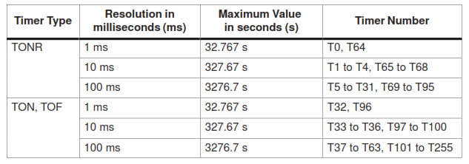
Timer number and resolutions
You cannot share the same timer numbers for TOF and TON. For example, you
cannot have both a TON T32 and a TOF T32.

Slide 33
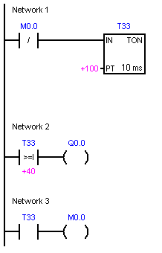
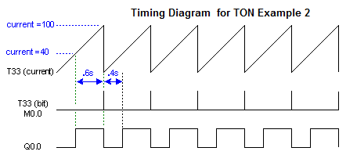
Bits and words of timer identifiers
Timer Identifiers (T0,T1, …) can be used both as logic flags or as integer registers.
RUN timer_on_example.awl

Slide 34
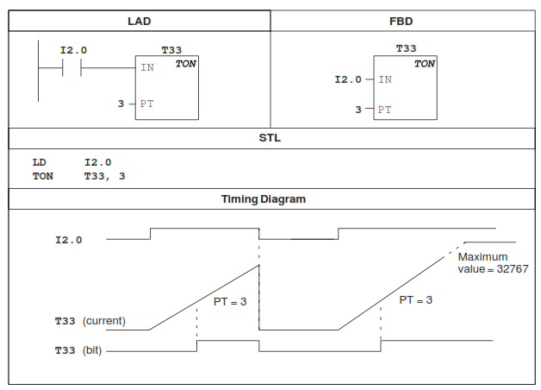
ON-delay timer diagram

Slide 35
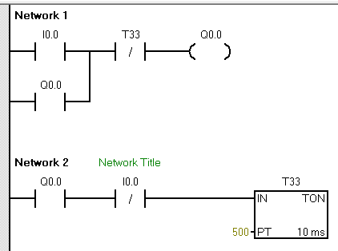
Timer on delay example
I0.0 activates Q0.0.
Q0.0 maintains its state (latch) since is also switched simultaneously in parallel with I0.0.
When T33 has elapsed, the latch function is broken via the T33 NC contact. Q0.0 goes off.
If T37 is not elapsed, the latch remains in force.
500*10ms = 5 seconds
RUN timer_on_example.awl

Slide 36
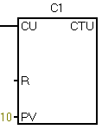
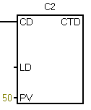
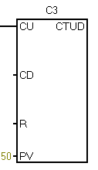
Count up/down counters
The Count Up/Down instruction (CTUD) counts up each time the count up (CU) input makes the transition from off to on, and counts down each time the count down (CD) input makes the transition from off to on. The current value Cxx of the counter maintains the current count. The preset value PV is compared to the current value each time the counter instruction is executed.
Upon reaching maximum value (32,767), the next rising edge at the count up input causes the current count to wrap around to the minimum value (--32,768). On reaching the minimum value (--32,768), the next rising edge at the count down input causes the current count to wrap around to the maximum value (32,767).
When the current value Cxx is greater than or equal to the preset value PV, the counter bit Cxx turns on. Otherwise, the counter bit turns off. The counter is reset when the Reset (R) input turns on, or when the Reset instruction is executed. The CTUD counter stops counting when it reaches PV.

Slide 37
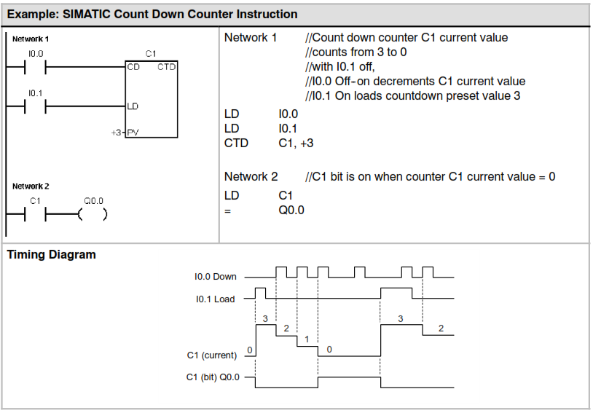
Count Down instruction

Slide 38
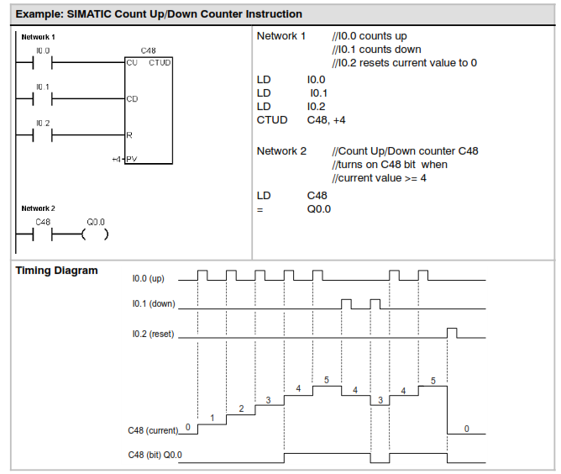
Count UP/Down instructions

Slide 39
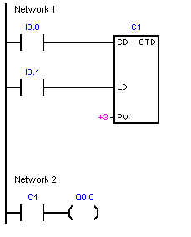
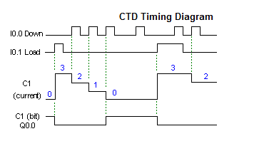
Counter down example

Slide 40
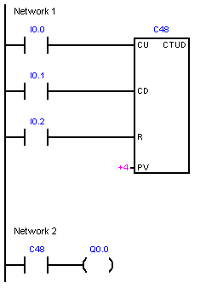
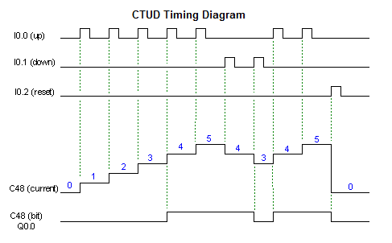
The CTUD counter

Slide 41
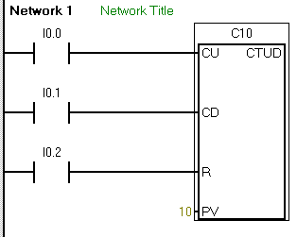
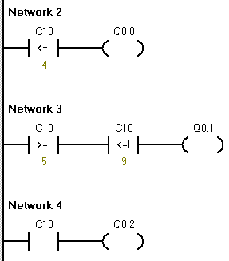
The CTUD example
Parts entering in a manufacturing assembling line are identified by a sensor connected to I0.0
Parts leaving the line are identified by a sensor connected to I0.1
If parts in the line are below 5, a light in Q0.0 must turn on.
If parts are between 5 and 9, turn on Q0.1
If parts are equal or above 10, turn on Q0.2
Integer comparison
Test the flag of the counter
CTUD_example.awl

Slide 42
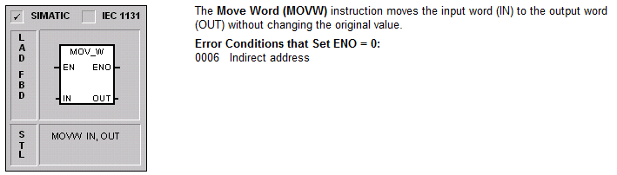


The Move, SUM and COMP instructins

Slide 43

Instruction Lists (IL)
NETWORK 1
LD I0.0
A I0.1
= Q0.0
NOT
= Q0.1
NETWORK 2
LD I0.2
ON I0.3
= Q0.2
NETWORK 3
LD I0.4
LPS //Logical push stack
EU //edge up
S Q0.3, 1
= Q0.4
LPP //logical pop stack
ED //edge down
R Q0.3, 1
= Q0.5
Let’s try in Micro/Win

Slide 44
Example 1
Translate these logic functions into corresponding LADDER diagrams:

Slide 45

Solution
Translation of f1

Slide 46

Resolution of example 1
Translation of f2

Slide 47
GRAFCET
A denominação GRAFCET tem origem numa abreviatura francesa: Graphe Fonctionnel de Commande, Etapes Transitions (gráfico funcional de comandos estado transição).
O GRAFCET é um método gráfico de descrição do funcionamento da parte de comando de um automatismo concebido com o objectivo de permitir a simplificação da representação de processos complicados.
O GRAFCET, especialmente destinado para o controlo de máquinas e processos sequenciais, é comparável ao uso dos fluxogramas usados na programação de computadores.
Para o representar é utilizada uma sucessão alternada de ESTADOS ou ETAPAS e TRANSIÇÕES.
Um processo é decomposto em estados que serão activados sucessivamente.

Slide 48

Sequences and convergence/divergences “and” “or”
Etapa inicial
Diverg. “ou”
*
Etapa activa
Diverg. “e”
Conv. “e”
conv. “ou”

Slide 49

Grafcet: condições de transição de estado

Slide 50

Grafcet: activação das saídas

Slide 51
Ladder vs Grafcet

Slide 52
Models translation
Conversion from … into …
GRAFCET -> LADDER -> IL
Petri nets -> LADDER -> IL

Slide 53


Models conversion
Conversão Petri nets -> diagramas Ladder.
Conversão grafcet-> diagramas Ladder.

Slide 54

Petri nets
Assumir que alguns “places” representam estados de sensores;
Assumir uma rede interpretada (acções associadas a transições e “places”);
Places P={p1,p2, p3, p4, p5}
Transitions T={t1,t2,t3,t4}
Inputs I(t1)={p1}
…
Outputs O(t1)={p2, p3, p5}
…
Marks m_{i}=<1,0,1,0,2>
Capacity c=<2,1,3,1,4>
Availability A_{i} = c - m_{i} =<1,1,2,1,2>
di =<0,0,0,0,0> delay (timed petri nets)

Slide 55


Conversão “Petri Net” -> Diag. Ladder (generalized method)
Fazer marcação inicial.
Verificar se cada transição está habilitada (enabled), através de I(t_{i}) e O(t_{i}):
∀p ∈ I : m(p) >=w(p, t_{i})
∀p ∈ O: a(p) >=w(t_{i}, p)
Fazer o disparo das regras habilitadas:
∀p ∈ P : m’(p) = m(P) -w(p, t_{i})+w(t_{i}, p)
(se w(x,y) não existir para uma dada transição, assumir zero).
Executar as acções semanticas às transições (incluíndo sensores)
Executar as acções semânticas associadas aos “places”.
I(t1)
O(t1)
(CONVERSÃO DEVERÁ SER FEITA POR SOFTWARE,
Following slides describe convertion for SAFE Petri Nets)

Slide 56



Conversion example
System bit Sm0.1 is true only at the first CPU clock, then it remains false. It is useful for setting initial states.

Slide 57





Conversion traffic_ligths

Slide 58



Conflicting states (version 1)
This solution does not warrant only one transition fires

Slide 59

Conflicting states (version 1) (prioritize transition T0)
This solution always favors transition To

Slide 60

Exercise
Controlo de um semáforo de tráfego rodoviário
As luzes são: Q0.0: verde (30 seg.); Q0.1:amarelo (5 seg); Q0.2: Vermelho (40 seg);
O ciclo de trabalho inicia com I0.0 no estado 1.
P1
T1

Slide 61

The Siemens Micro/Win software

Slide 62

Installing Micro/win
Copy Microwin.exe from installation to the root of PC disck “c:\” (this is the license file, not a virus).
Try one of the provided installers which works in your windows version 7/8/10.

Slide 63

Download a project

Slide 64
Lab work
Petri Nets
LADDER/IL
Conversion Petri Nets -> LADDER
MicroWin
Simulador PLC S7-200
Simulador estação de lavagem
Utilização no PLC e Kit carwash

Slide 65

The PLC simulator

Slide 66

Simulador Estação Lavagem

Slide 67

Kit car wash station
Let’s do it! ☺

Slide 68
Accessing Help files of MicroWin
How to read an old “.hlp file” on Windows 10 (x64, or, x86)
How to read an old “.hlp file (*)” on Windows 10 (x64, or, x86) (*): The “.hlp file” must be read, without any problem, on Windows XP, 2000, ME, or, 98/98SE. The following is a procedure to be able to read an old “.hlp file” on Windows 10 (x86). (1) First, get the winhlp32.exe existing in the Windows directory of Windows XP (x86). (2) Make a temporary folder (for example D:\TEMP) on the HDD of Windows 10 (x86). (3) Copy the winhlp32.exe (obtained by the #(1) step) into the temporary folder D:\TEMP. (4) Make a file, named Win10-Hlp32-Fix.cmd, by using the text editor. All of the contents of the file (Win10-Hlp32-Fix.cmd) are as follows; @echo off set crtpth=%CD% takeown /f "%windir%\winhlp32.exe" >nul icacls "%windir%\winhlp32.exe" /grant *S-1-5-32-544:F >nul copy /y "%crtpth%\winhlp32.exe" %windir% icacls "%windir%\winhlp32.exe" /setowner "NT Service\TrustedInstaller" >nul echo. echo Done. echo. echo Press any key to Exit pause >nul exit (5) Therefore, you can find two files (winhlp32.exe and Win10-Hlp32-Fix.cmd) in the D:\TEMP. (6) Open the Command Prompt window, by selecting "Run as administrator.” (7) Then, move the prompt to the D:\TEMP directory, by using Change Directory (CD)command. (8) Under this condition, execute the Win10-Hlp32-Fix.cmd command in the D:\TEMP directory. (9) After the completion of this execution, you can read an old “.hlp file” on Windows 10 (x86). Remarks: In the case of Windows 10 (x64), please use the winhlp32.exe existing in the Windows directory of Windows XP (x64).
http://www.tenforums.com/general-discussion/16982-cant-read-older-hlp-files-windows-10-a.html

